Slide 1
Applications and Challenges of the Sraffian Supermultiplier
Julia Braga (UFF/Brazil)
Ricardo Summa (UFRJ/Brazil)
April 28th, 2020
HEA Webinar Series 2021

Slide 2
Supermultiplier mechanism -> Interaction between Income multiplier and Investment accelerator.
Its an old idea that practically disappeared in the mid-1950s and was rescued by Serrano (1995)- combining with the surplus approach.
The stability of the model was provided by Freitas and Serrano (2015) only in 2015. It does not suffer from Harrod’s instability.
Now it is a widespread > named as a class of ‘autonomous demand led growth models’ by Allain (2015, 2019), Lavoie (2016, 2017), Palley (2019) Fazzari et al. (2020) Dutt (2019))
Foundation of the model is the principle of capital adjustment. The baseline model is for what is common to every capitalist economy.

Slide 3
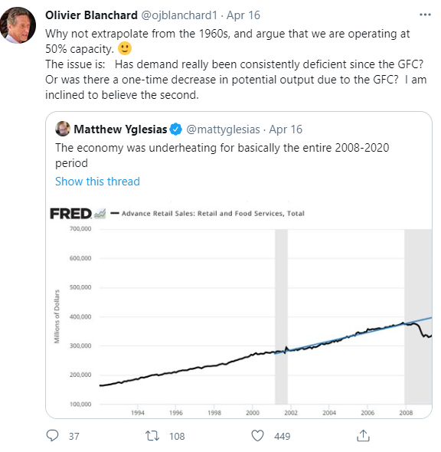
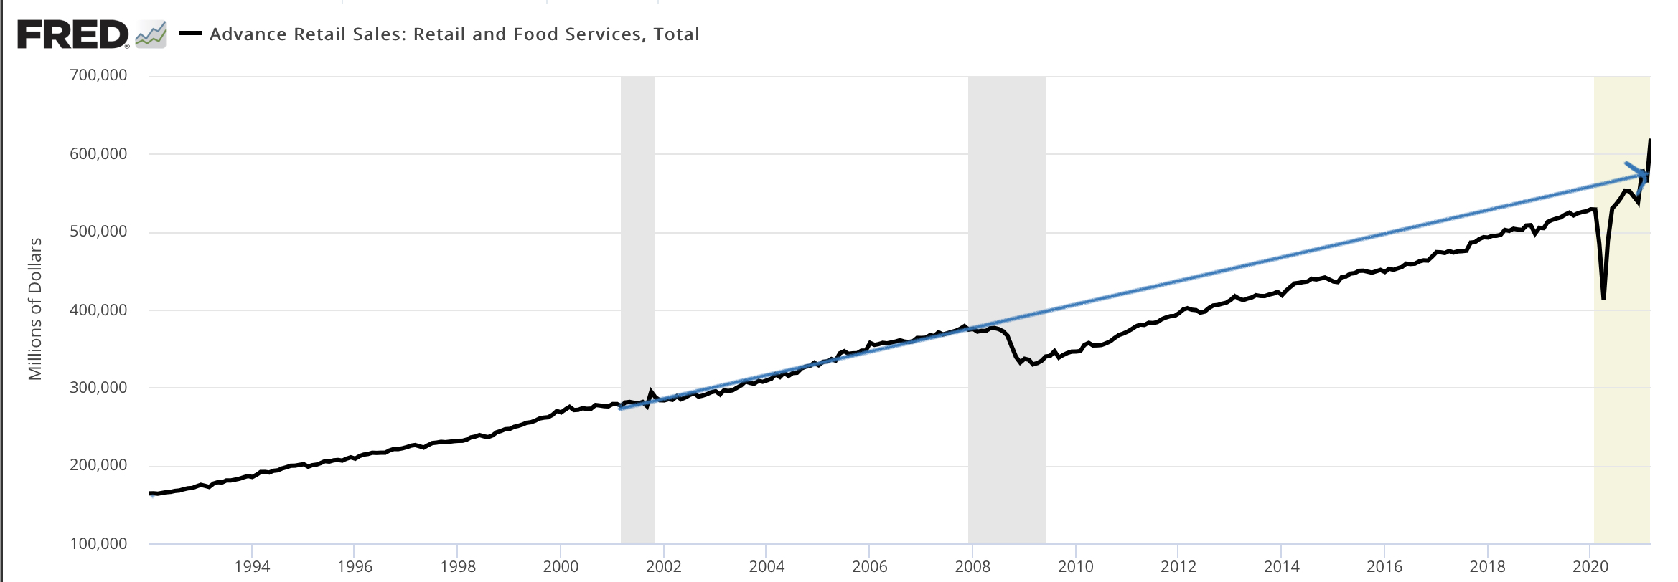

Slide 4
1) If Blanchard followed the supermultiplier approach, he wouldn’t have implied a capacity utilization of 50%. If demand falls to a lower level, stock of capital will slowly decrease, and this means that the degree of utilization increases again (there is an adjustment, even if it does not return entirely to the previous level).
2) It's a level effect, but in order to avoid the decrease of the capital stock, autonomous demand must grow at a faster rate.

Slide 5
Common Misconceptions:
“Its for the long period not for the short run”. NO!-> Remember Samuelson's Multiplier Accelerator Interaction Model meant to explain business cycles.
Non-Capacity Creating Autonomous Demand X Exogenous Demand. Autonomous but not exogenous :
It is autonomous from ‘production decisions’. Not systematically related with production decisions but there is no closed theory for their determinants. But it can be endogenous to the income because, for instance, a policy rule.
“There is no room for autonomous investment” NO! (e.g. innovation); But by principle of capital adjustment, aggregate capacity creating investment must follow autonomous demand.

Slide 6
Extensions have been developed to include more realistic elements into the Supermultiplier model
Different components of autonomous demand and its determinants
The role of macroeconomic policy: with fiscal and monetary Policy Rules to determine autonomous components of the demand
Applied to analyze concrete experiences in advanced and developing economies. This approach has flexibility to deal with different realities
(Policy, external, financial) Constraints to demand-led growth - BoP restrictions; Financial Bubbles and Crisis; Conflict Inflation

Slide 7
Extensions of the baseline Supermultiplier Model are compatible with:
Autonomous component of investment; deal with by different ways- autonomous expectations (Serrano, Freitas and Bhering, 2019); Innovative autonomous investment as shocks in the expected growth rate (Cesaratto et al, 2003); Technical progress in the investment function (Nah and Lavoie, 2019a); Real interest in investment function (Dutt, 2020) >
(Short run) : Real interest rate and autonomous demand: monetary policy can influence expenditures in durable goods consumption and residential investment.(Summa, 2016; Serrano, Summa and Garrido-Moreira, 2020)
Demographic factors and residential investment growth: pattern of this kind of non-capacity creating autonomous demand in advanced and stable countries with regulated and well-behaved labour, credit and real estate markets and strong social security coverage (Allain, 2019).

Slide 8
Extensions of the baseline Supermultiplier Model are compatible with:
Financial Constraints to autonomous demand growth: In the perspective of a Stock and Flow consistent approach : include worker’s debt to income relation ->Pariboni (2016), Mandarino at al. (2020); residential investment and households’ debt -> Petrini and Teixeira (2020); public debt to output relation -> Freitas and Cavalcanti (2020); indebtedness of the non-financial business sector -> Freitas and Brochier (2019).
External constraints: external imbalances and unsustainable path of foreign debt-to-export ratio (Serrano and Souza, 2000, Medeiros and Serrano, 2006) maximum acceptable level of foreign debt-to-export ratio (Bhering et al., 2019);
Real resources constraints : Labor force and productivity (Palley, 2019; Fazzari et al.,2020, Nah and Lavoie (2019a,b));
Policy constrained demand-led growth: conflict inflation and inflation targeting (Summa, 2016, Serrano, 2019), other policy rules, etc.

Slide 9
Research agenda on empirical and applied versions of the Supermultiplier model
1) Accelerator is very easy to obtain econometrically
2) Consumption Function (multiplier) not so easy – because since non capacity creating autonomous demand (especially autonomous consumption) is not constant over time, you must proper identify this component and separate it from induced consumption
(2) No so easy as well is to differentiate the impact of individual components of autonomous demand since it is the group of non capacity creating autonomous demand that minds.

Slide 10
Research agenda on empirical and applied versions of the Supermultiplier model
1) Some papers use econometric tools (with differ methodological approaches) for different countries and periods (Braga, 2006, Medici, 2011, Girardi and Pariboni, 2016,2020; Fiorito, 2018; Braga, 2020; Pérez-Montiel and Erbina, 2020; Fazzari et al. 2020; Girardi et al., 2020; Haluska et al., 2020);
(2) Multi- sectorial (input-output) Supermultiplier models calibrated by empirical data (Freitas and Dweck (2010), Cornelio, Freitas and Busato, 2018, Portella-Carbo (2016), Portella-Carbo and De Juan (2019));
(3) Simulations of the Supermultiplier mechanism with stylized calibrated parameters (Haluska, Summa and Serrano (2021)).

Slide 11
Brazilian Keynesian Association
Since 2008
2nd largest Keynesian Association (150 signatories)
14th Meeting 2021
Products :
Books (3rd)
Thematic Reports - collections of members
III WORKSHOP ALUMNI AKB
Students graduated from the AKB School.
V ESCOLA DA AKB-YSI 2021. AKB School (5th) - Largest Summer School in Brazil
Partnership with YSI INET SEP.
https://associacaokeynesianabrasileira.org/

Slide 12
Thank you!
jbraga@id.uff.br

